Slide 1
Membranes and glands

Slide 2
MEMBRANES
A tissue membrane is a thin layer or sheet of cells that covers the outside of the body (skin), organs (pericardium), internal passageways that open to the exterior of the body (mucosa of stomach), and the lining of the moveable joint cavities.
There are two basic types of tissue membranes:
connective tissue membranes
Epithelial membranes.

Slide 3
TYPES OF MEMBRANES
The two broad categories of tissue membranes in the body are
(1) connective tissue membranes, which include synovial membranes, and
(2) epithelial membranes, which include mucous membranes, serous membranes, and the cutaneous membrane, in other words, the skin.

Slide 5
Connective Tissue Membranes
The connective tissue membrane is formed solely from connective tissue. These membranes encapsulate organs, such as the kidneys, and line our movable joints.
A synovial membrane is a type of connective tissue membrane that lines the cavity of a freely movable joint. For example, synovial membranes surround the joints of the shoulder, elbow, and knee.
Fibroblasts in the inner layer of the synovial membrane release hyaluronan into the joint cavity. The hyaluronan effectively traps available water to form the synovial fluid, a natural lubricant that enables the bones of a joint to move freely against one another without much friction.

Slide 6
Epithelial Membranes
1. The mucous membrane is a composite of connective and epithelial tissues. Sometimes called mucosa.
These epithelial membranes line the body cavities and hollow passageways that open to the external environment, and include the digestive, respiratory, excretory, and reproductive tracts.
Mucous, produced by the epithelial exocrine glands, covers the epithelial layer.

Slide 7
2. A serous membrane is an epithelial membrane composed of mesodermally derived epithelium called the mesothelium that is supported by connective tissue.
These membranes line cavities that do not open to the outside, and they cover the organs located within those cavities.
Serous membranes have two layers: an outer layer that lines the body cavity call parietal and an inner layer that covers internal organs called visceral.
Serous fluid secreted by the cells lubricates the membrane and reduces abrasion and friction between the two layers. Serous membranes are identified according locations.
Three serous membranes line the thoracic cavity; the two pleura that cover the lungs and the pericardium that covers the heart. A fourth, the peritoneum, is the serous membrane in the abdominal cavity that covers abdominal organs and forms double sheets of mesenteries that suspend many of the digestive organs.

Slide 8
3. The cutaneous membrane :The skin is an epithelial membrane also called the cutaneous membrane. It is a stratified squamous epithelial membrane resting on top of connective tissue. The apical surface of this membrane is exposed to the external environment and is covered with dead, keratinized cells that help protect the body from desiccation and pathogens.

Slide 9
GLANDS
Glands are group of epithelial cells which produce specialized secretions.
Glands that discharge their secretion onto the epithelial surface of hollow organs, either directly or through a duct, are called exocrine glands.
Other glands discharge their secretions into blood and lymph. These are called endocrine glands (ductless glands) and their secretions are hormones.

Slide 10
Classification of glands
1. Endocrine glands
2. Exocrine glands
Unicellular
Multicellular-------a) simple
b)compound
3.Mixed glands

Slide 11
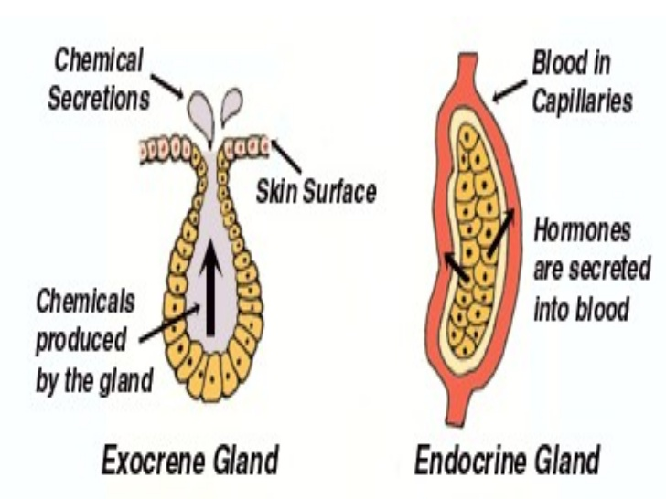

Slide 12
Endocrine glands
Endocrine glands discharge their secretions directly into the bloodstream.
They are ductless glands.
These glands secrete their products through the basal lamina into the blood stream and lack a duct system.
These glands often secrete hormones, and play an important role in maintaining homeostasis.
The pineal gland, thymus gland, pituitary gland, thyroid gland, and the two adrenal glands are all endocrine glands

Slide 13
Exocrine glands
Exocrine glands: Exocrine glands secrete their products through a duct onto an outer surface of the body, such as the skin or the gastrointestinal tract. Secretion is directly onto the apical surface.
i) Unicellular glands: unicellular glands lie among other cells of columnar or pseudo stratified epithelium. For eg; goblet cells which secrete mucous are, situated between non secretory epithelial cells.

Slide 14
ii) Multicellular
Simple glands: when all the secretory cells of an exocrine gland discharge into one duct, the gland is called a simple gland.
Compound glands: compound glands have a branching duct system. A group of secretory cells open into a small duct. These ducts unite to form larger ducts, which ultimately open on an epithelial surface.

